Slide 1
Physical Layer: “Computer Networks”, Tanenbaum, Chap2 (2.1, 2.2, 2.3, 2.5)
Functions
Fundamentals/Channel Capacity
Analog Overview
Digital Overview
Modulation
Media Types
twisted pair
coaxial cable
fiber
wireless

Slide 2
Physical Layer
Physical Layer
electrical/optical transmission of bits or symbols
physical control signals
Application layer
Transport layer
Network layer
Link layer
Physical layer
Application layer
Transport layer
Network layer
Link layer
Physical layer
message
segment
datagram
frame
bits
sender
packet switches
receiver
Notes:
Upper layers (2-5): all about “encapsulation”
Physical layer: all about “conversion”

Slide 3
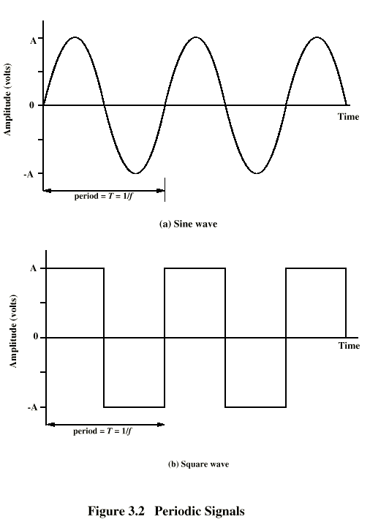
Periodic Signals
Peak Amplitude (A)
maximum strength of signal
volts
Frequency (f)
Rate of change of signal
Hertz (Hz) or cycles per second
Period = time for one repetition (T)
T = 1/f
Phase (φ)
Relative position in time
Notes:
Phase: represented as angle in the radial coordinate system (between 0 and 2\pi).

Slide 4
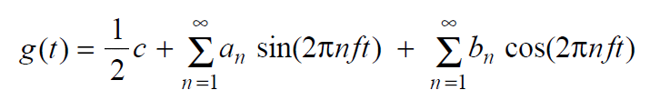
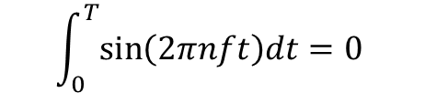
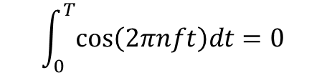
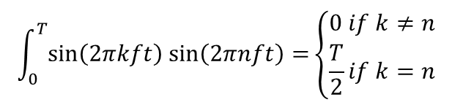
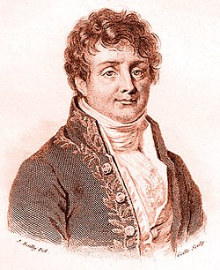
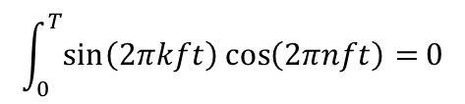
Fourier Analysis
Fourier theorem: A periodic signal (of period T) is made up of (possibly infinite) component signals
component signals are sine waves
f=1/T: fundamental frequency
The component waves satisfy:
dt
Jean-Baptiste Fourier
1768-1830
dt
Notes:
Fourier: a French mathematician in 18th centrury.

Slide 5
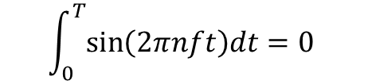
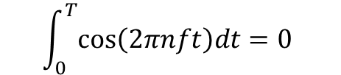
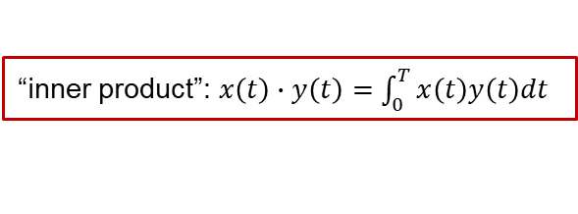



Fourier Analysis
Fourier theorem: A periodic signal (of period T) is made up of (possibly infinite) component signals
Define: x(t):=1, y_{n}(t):=sin(2πnft), z_{n}(t):=cos(2πnft)
{x(t), y_{n}(t), z_{n}(t)} is an orthogonal basis of {periodic signals of period T}
Fourier theorem → a basis
Pairwise orthogonal:
“inner product”: $x\left(t\right)∙y\left(t\right)=\int_{0}^{T}{x\left(t\right)y\left(t\right)dt}$
x(t) $⊥$ y_{n}(t), z_{n}(t)
y_{k}(t) $⊥$ y_{n}(t), $∀k≠n$
dt
dt
y_{k}(t) $⊥$ z_{n}(t)
Notes:
missing “dt” in bottom two equations

Slide 6




Fourier Analysis
A periodic signal (of period T) is made up of (possibly infinite) component signals
component signals are sine waves
f=1/T: fundamental frequency
The coefficients are given by:
Fourier coefficients ↔ original signal
$$\frac{a_{n}T}{2}$$
$$\frac{b_{n}T}{2}$$
$$\frac{cT}{2}$$
Notes:
c, a_n, b_n: strength of the signal at frequency 0, nf

Slide 7
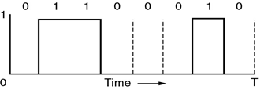
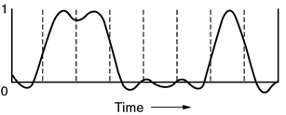
Why Fourier Analysis?
Transmission medium will “selectively” pass signals from 0-frequency to some cutoff frequency f_{c} (physical property of the medium)
no sharp cutoff → f_{c}: frequency when power is attenuated by half (aka “bandwidth”)
ASCII code for ‘b’, represented by a discrete signal
equally attenuated at all frequencies
0.5
strongly attenuated at frequencies > f_{c}
Notes:
lecture 1.
The point in representing the signal in frequency domain is the physical medium does “frequency-selective attenuation”.
In contrast to using bandwidth to denote link capacity (bps), “bandwidth” here means how wide a frequency band can pass through the link (without being attenuated by more than half).

Slide 8
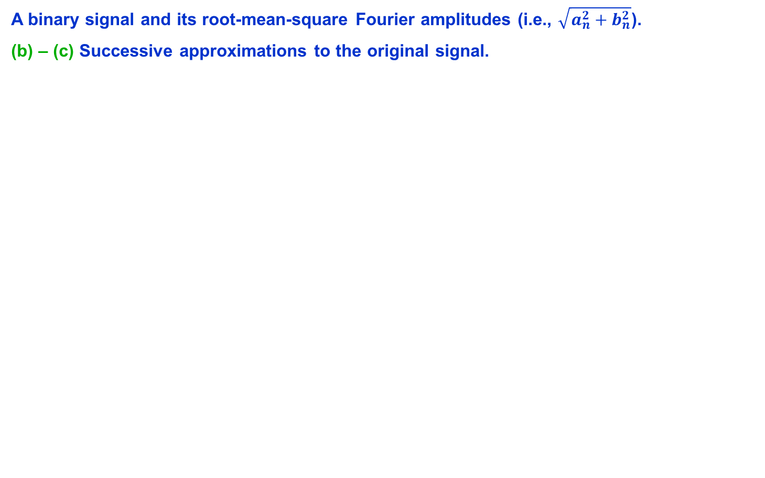
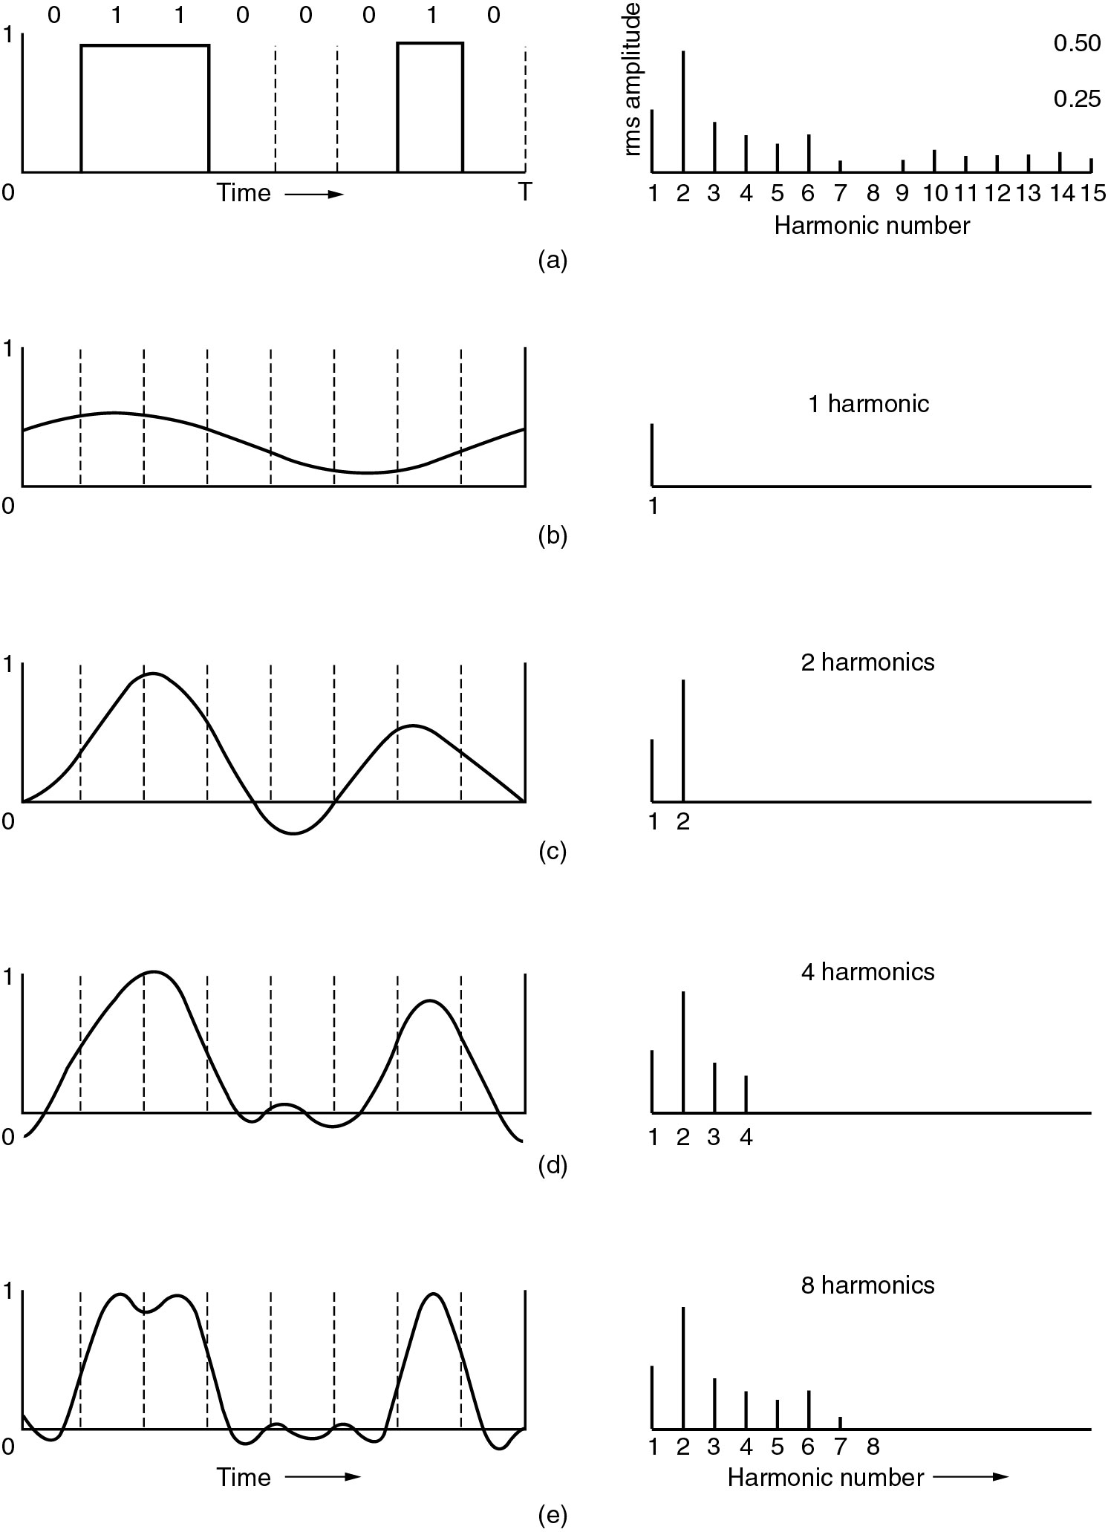
Bandwidth-Limited Signals

Slide 9
Bandwidth-Limited Signals
(d) – (e) Successive approximations to the original signal.

Slide 10
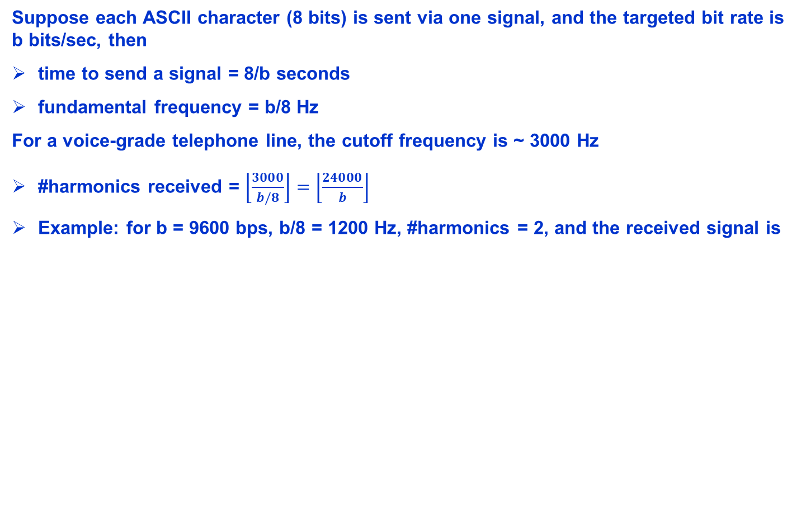
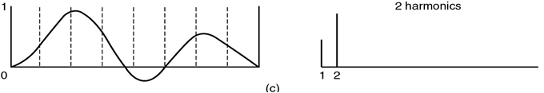
Relation between Data Rate and #Harmonics
0
Notes:
quality of sending ASCII characters (e.g., for web) over a regular telephone line (as in DSL network)

Slide 11
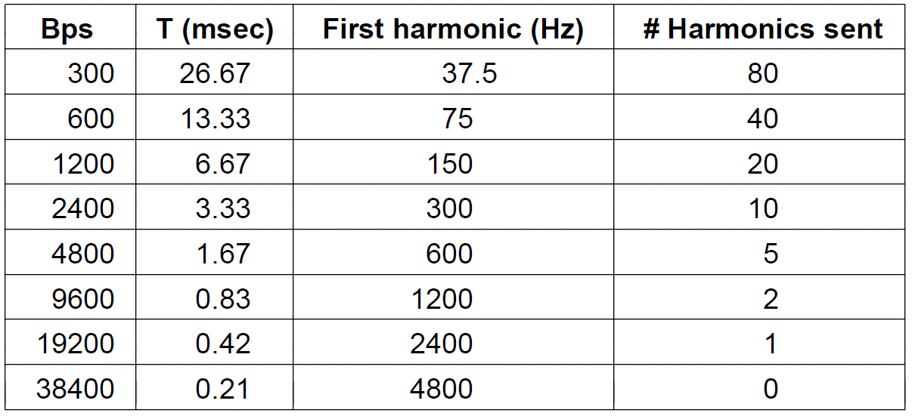
Relation between Data Rate and #Harmonics
higher bit rate → fewer harmonics → higher bit error rate
Computer Networks, Fifth Edition by Andrew Tanenbaum and David Wetherall, © Pearson Education-Prentice Hall, 2011

Slide 12
Review
Physical layer service
Signal composition:
Fourier analysis
Notes:
End of lecture 1.

Slide 13
Analog and Digital Data Transmission
Data
Logical entities that convey meaning (e.g., content of a call, content of a file)
can be continuous (analog data) or discrete (digital data)
Signals
Physical representations of data (e.g., electric pulse, electromagnetic wave)
Signal is the means by which data are propagated
can be continuous (analog signal) or discrete (digital signal)
Can use analog signal to carry digital data
Modem
Can use digital signal to carry analog data
Compact Disc audio
Notes:
Can have all 4 combinations:
Digital Data, Analog Signal
Analog Data, Digital Signal
Analog Data, Analog Signal
Digital Data, Digital Signal

Slide 14
Modulation and Coding
Digital Data, Analog Signal
Analog Data, Digital Signal
Analog Data, Analog Signal
Digital Data, Digital Signal
Notes:
Modulation: modify a base signal to encode information in the data

Slide 15
Digital Data Modulation
Modem
modulator (D-to-A converter) & demodulator (A-to-D converter)
Two classes of modulation schemes:
baseband modulation
signal occupies frequency from 0 to a cutoff frequency
common for wired channels
passband modulation
signal occupies a shifted frequency band (not starting from 0)
common for wireless channels
frequency
0
f_{c}
frequency
0
Notes:
Example for passband “carrier frequency”: 0.9-6 GHz
Millimeter wave: frequency 30-300 GHz

Slide 16
Baseband Modulation
Common for wired channels
Basically aim at encoding a sequence of 0’s and 1’s by two voltage levels
Schemes (aka line codes):
Nonreturn to Zero (NRZ)
Nonreturn to Zero Inverted (NRZI)
Biphase: Manchester, Differential Manchester
Bipolar: Alternate Mark Inversion (AMI)
Pay attention to 2 properties: whether the code is (1) self-synchronized, (2) balanced
“self-synchronized signal”: allows receiver to detect boundaries of bit intervals
“balanced signal”: positive voltages and negative voltages average to ~zero
non-zero average → DC component → wasted energy (DC component will be filtered out)
balanced signal can be used to calibrate receiver: use the average as detection threshold
Notes:
Basically about how to represent 0/1 by two different voltage levels
“balanced signal”: having equal portions of positive and negative voltage (average to zero) -> balanced signal is good because there is no DC component, which will be filtered out (strongly attenuated by some media or receiver) and hence waste energy.

Slide 17

Nonreturn to Zero (NRZ)
Two different voltages for 0 and 1 bits
E.g. negative voltage for 0, positive voltage for 1
Voltage constant during bit interval
no transition, i.e., “no return to zero voltage”
Intuitive, but seldom used in practice

Slide 18
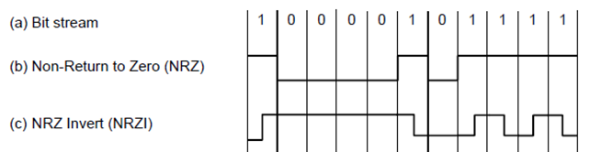
Nonreturn to Zero Inverted (NRZI)
NRZ causes synchronization issues when sending long runs of 0’s or 1’s
the signal looks almost identical when sending a run of 100 0’s and a run of 101 0’s
Idea: Data encoded as presence or absence of signal transition
Transition (low-to-high or high-to-low) denotes a 1
No transition denotes a 0
An example of “differential encoding”, used in USB (Universal Serial Bus)
Q: How about long runs of 0’s?
A: code the bit sequence to “break up” the 0’s (see Figure 2-21. 4B/5B mapping)
Notes:
A: code a group of bits to a slightly longer group of bits that does not contain long runs of 0’s, e.g., 4B/5B code (see textbook Figure 2-21)

Slide 19
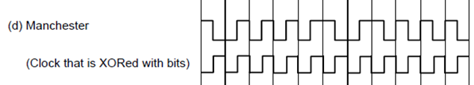

Biphase
Idea: Send both the data and the clock signal
Manchester
Transition in middle of each bit period, transmitted signal = clock XOR data
Low to high represents 0
High to low represents 1
Used by IEEE 802.3 (Ethernet)
Differential Manchester
End-of-bit transition is only clocking
Mid-bit transition represents 0
No mid-bit transition represents 1
Note: this is also a differential encoding scheme
Used by IEEE 802.5 (token ring)
data
signal

Slide 20

Bipolar Encoding (Alternate Mark Inversion (AMI))
Biphase codes (Manchester & differential Manchester) are balanced
Another balanced code: Alternate Mark Inversion (AMI)
3 voltage levels: -1 V, 0 V, +1 V
zero is represented by 0 V
one is represented by +1 or -1 V alternatingly
Notes:
Besides clock synchronization, another desirable property of signal is “balancing”.
Bipolar code (AMI) is more energy efficient.

Slide 21
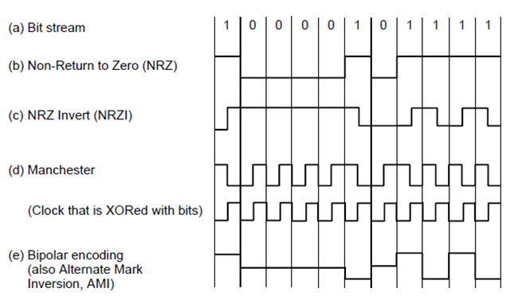
Summary of Line Codes (for Baseband Transmission)
line code | synchronized | balanced
NRZ | N | N
NRZI | Y* | N
Biphase | Y | Y
Bipolar | N | Y
Computer Networks, Fifth Edition by Andrew Tanenbaum and David Wetherall, © Pearson Education-Prentice Hall, 2011

Slide 22
Review
Digital data → signal conversion
modulation for baseband transmission
modulation for passband transmission
Notes:
End of lecture 2.

Slide 23
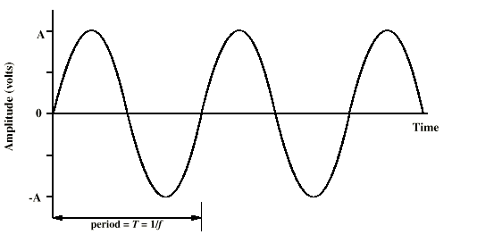
Passband Modulation
Common for wireless channels
Signal occupies a shifted frequency band (not starting from 0)
data encoded by modifying (“modulating”) a carrier signal
frequency
0
carrier signal

Slide 24
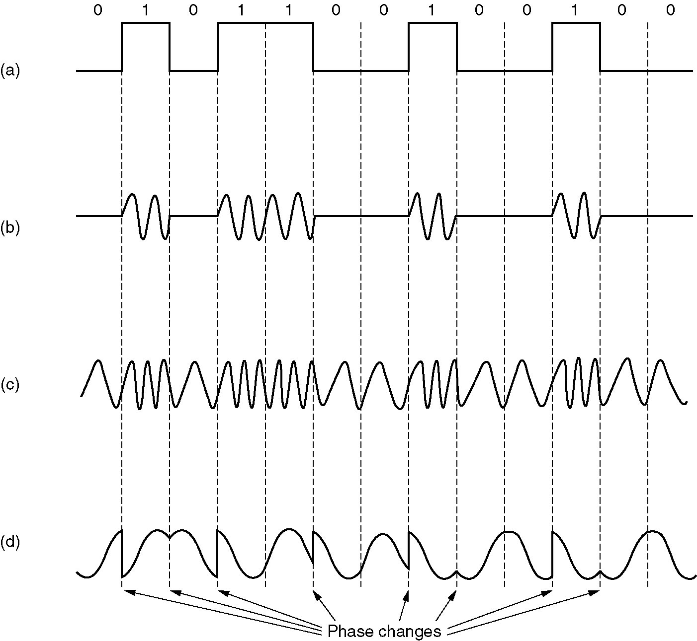
Methods for Passband Modulation
(a) A binary signal
(b) Amplitude modulation
(c) Frequency modulation
(d) Phase modulation
Notes:
The idea of passband modulation is to start with a baseline signal within the targeted frequency band, e.g., a sine wave with that frequency, and modify one or multiple parameters of the baseline signal to encode information.

Slide 25

Amplitude Shift Keying
Values represented by different amplitudes of carrier
Usually, one amplitude is zero
i.e. presence and absence of carrier is used
Susceptible to sudden gain changes
Inefficient
Used over optical fiber
Notes:
* Shift Keying is a physical layer jargon for saying “*-based modulation”

Slide 26
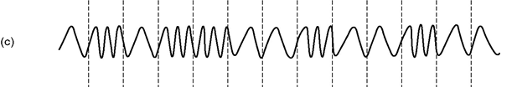
Frequency Shift Keying
Values represented by different frequencies (near carrier)
Less susceptible to error than ASK
High frequency radio
Even higher frequency on LANs using co-ax

Slide 27
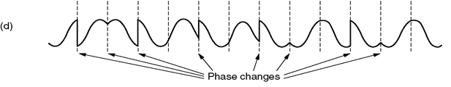
Phase Shift Keying
Phase of carrier signal is shifted to represent data
Binary Phase Shift Keying (BPSK):
Quadrature Phase Shift Keying (QPSK): More efficient use of channel by letting each signal element representing more than one bit
e.g. shifts of {0, π/2, π, 3π/2} or {π/4, 3π/4, 5π/4, 7π/4}
Each element represents two bits
Can use 8 phase angles and have more than one amplitude
9600bps modem use 12 angles, four of which have two amplitudes
Notes:
skipped material:
Differential PSK
Phase shifted relative to previous transmission rather than some reference signal

Slide 28
Quadrature Amplitude Modulation
Simultaneously modulate phase and amplitude to transmit data at a higher rate
For example:
Quadrature Phase Shift Keying (QPSK): Use 4 shift values to represent two bits per signal element
e.g. shifts of {0, π/2, π, 3π/2} or {π/4, 3π/4, 5π/4, 7π/4}
Each element represents 2 bits (i.e., log₂ 4)
Quadrature Amplitude Modulation (QAM)-16: Use 12 phase shifts, 4 of which have 2 amplitude levels
#possible signal elements = 8 + 4*2 = 16
Each element represents 4 bits (i.e., log₂ 16)

Slide 29
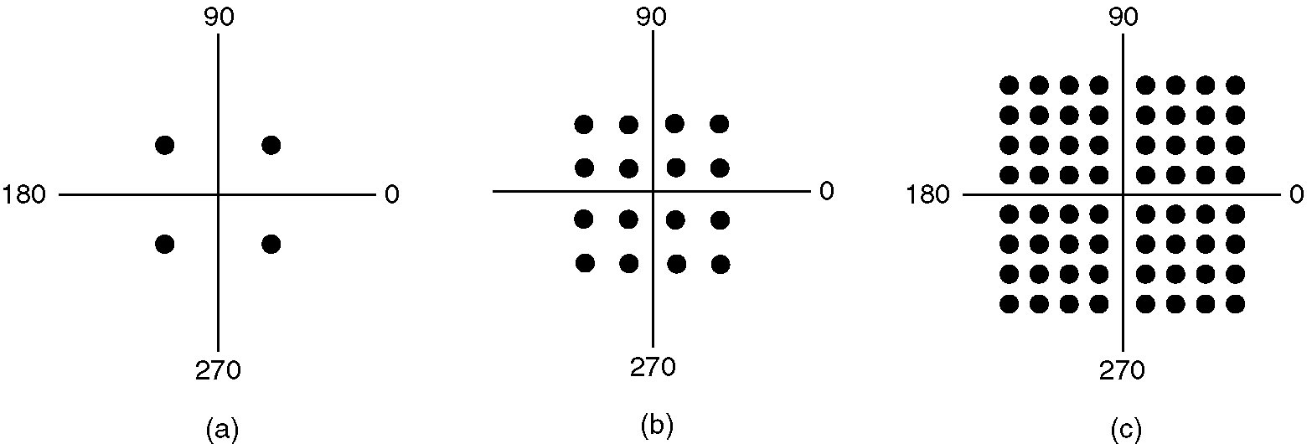
Constellation diagram
An easier way of representing possible signal elements (symbols) of a modulation scheme
amplitude
phase
(a) QPSK.
(b) QAM-16.
(c) QAM-64.
2 bits/symbol
4 bits/symbol
6 bits/symbol

Slide 30
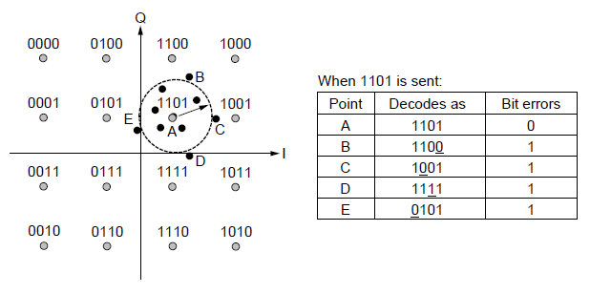
Decoding example: QAM
Gray-coded QAM-16
Tradeoff: higher data rate → higher error rate
Computer Networks, Fifth Edition by Andrew Tanenbaum and David Wetherall, © Pearson Education-Prentice Hall, 2011

Slide 31
Review
Digital data → signal conversion
baseband: line codes
passband: ASK, FSK, PSK, QAM
Notes:
End of lecture 3.

Slide 32
Transmission Media
Guided
Twisted Pair
Coaxial cable
Optical fiber
Free space (unguided)
Wireless
Notes:
signal impairments: attenuation, noise, multipath fading, interference

Slide 33
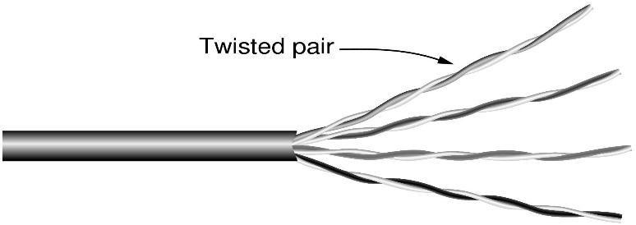
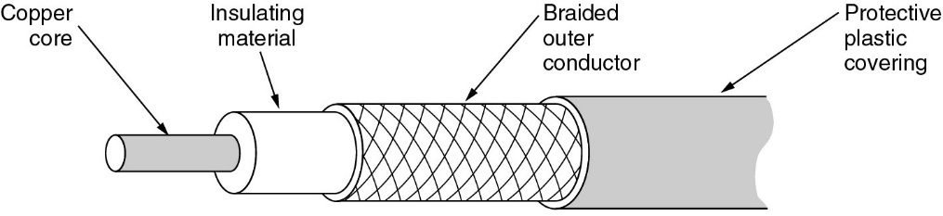
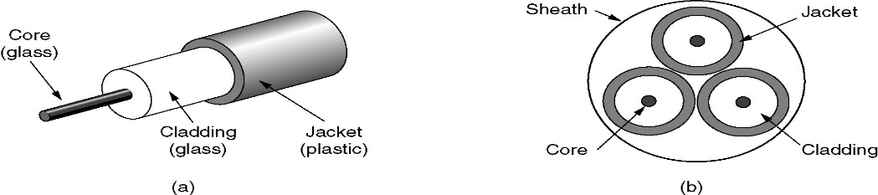
Transmission Media
Guided
Twisted Pair
telephone network, DSL, Ethernet
amplifiers every 5km to 6km
repeater every 2km or 3km
Coaxial cable
TV network, Cable
amplifiers every few km
repeater every 1km
Optical fiber
backbone, datacenter, HPC
repeater spaced 10s of km
Free space
Wireless
single hop
multi-hop allowed
transmitter
receiver
other transmitter
T + t
T
transmitted signal
received signal
or
Notes:
signal impairments: attenuation, noise, multipath fading, interference

Slide 34
Summary of Physical Layer
Physical layer fundamentals
Fourier analysis, signal vs. data, analog vs. digital, data rate vs. bandwidth
Modulation
digital → analog, analog → digital, analog → analog, digital → digital
Media Types
guided: twisted pair, coaxial cable, fiber
free-space: wireless
Notes:
End of lecture 4.

Slide 35
Synthesis: a day in the life of a web request
Journey down protocol stack complete!
application, transport, network, link, physical
Putting-it-all-together: synthesis!
goal: identify, review, understand protocols (at all layers) involved in a seemingly simple scenario: requesting a web page
scenario: student attaches laptop to campus network, requests/receives www.google.com

Slide 36





A day in the life: scenario
browser
DNS server
Comcast network
68.80.0.0/13
school network
68.80.2.0/24
web page
web server
Google’s network
64.233.160.0/19
64.233.169.105

Slide 37

A day in the life… connecting to the Internet
DHCP
DHCP
UDP
IP
Eth
Phy
connecting laptop needs to get its own IP address, addr of first-hop router, addr of DNS server: use DHCP
DHCP
DHCP
DHCP
DHCP
DHCP request encapsulated in UDP, encapsulated in IP, encapsulated in 802.3 Ethernet, modulated by Manchester code
DHCP
DHCP
UDP
IP
Eth
Phy
DHCP
DHCP
DHCP
DHCP
router
(runs DHCP)
Ethernet frame broadcast (dest: FFFFFFFFFFFF) on LAN, received at router running DHCP server
Ethernet demuxed to IP demuxed, UDP demuxed to DHCP

Slide 38
A day in the life… connecting to the Internet
DHCP
DHCP
UDP
IP
Eth
Phy
DHCP server formulates DHCP ACK containing client’s IP address, IP address of first-hop router for client, name & IP address of local DNS server
DHCP
DHCP
DHCP
encapsulation at DHCP server, frame forwarded through LAN, demultiplexing at client
DHCP
DHCP
UDP
IP
Eth
Phy
DHCP
DHCP
DHCP
router
(runs DHCP)
DHCP
DHCP client receives DHCP ACK reply
Client now has IP address, knows name & addr of local DNS
server, IP address of its first-hop router

Slide 39
A day in the life… ARP (before DNS, before HTTP)
DNS
UDP
IP
Eth
Phy
before sending HTTP request, need IP address of www.google.com: DNS
DNS
DNS
DNS
ARP
ARP query
DNS query created, encapsulated in UDP, encapsulated in IP, encapsulated in Eth. To send frame to router, need MAC address of router interface: ARP
ARP
ARP reply
Eth
Phy
ARP query broadcast, received by router, which replies with ARP reply giving MAC address of router interface
router
(runs DHCP)
client now knows MAC address of first hop router, so can now send frame containing DNS query

Slide 40
A day in the life… using DNS
DNS
UDP
IP
Eth
Phy
DNS
DNS server
DNS
UDP
IP
Eth
Phy
DNS
DNS
DNS
DNS
DNS
DNS
DNS
DNS
Comcast network
68.80.0.0/13
IP datagram forwarded from campus network into Comcast network, routed (tables created by RIP, OSPF, IS-IS and/or BGP routing protocols) to DNS server
router
(runs DHCP)
IP datagram containing DNS query forwarded via LAN switch from client to 1st hop router
demuxed to DNS server
DNS server replies to client with IP address of www.google.com

Slide 41
A day in the life…TCP connection carrying HTTP
HTTP
HTTP
TCP
IP
Eth
Phy
SYNACK
SYN
SYNACK
SYN
SYNACK
SYN
SYN
to send HTTP request, client first opens TCP socket to web server
router
(runs DHCP)
TCP
IP
Eth
Phy
TCP SYN segment (step 1 in 3-way handshake) inter-domain routed to web server
SYNACK
SYN
SYNACK
SYN
SYNACK
SYNACK
SYN
web server responds with TCP SYNACK (step 2 in 3-way handshake)
web server
64.233.169.105
TCP connection established (for client!)

Slide 42
A day in the life… HTTP request/reply
HTTP
HTTP
TCP
IP
Eth
Phy
web page finally (!!!) displayed
HTTP
HTTP
HTTP
HTTP
HTTP
HTTP
HTTP
HTTP
HTTP request sent into TCP socket
router
(runs DHCP)
IP datagram containing HTTP request routed to www.google.com
HTTP
HTTP
TCP
IP
Eth
Phy
HTTP
HTTP
HTTP
web server responds with HTTP reply (containing web page)
HTTP
web server
64.233.169.105
IP datagram containing HTTP reply routed back to client
Notes:
Lecture 4.

Slide 43
Skipped slides

Slide 44
Transmission Impairments
Signal received may differ from signal transmitted
Analog - degradation of signal quality
Digital - bit errors
Caused by
Attenuation
Delay distortion
Noise
Interference
Q: How to reduce impairments?
A: Strategy differs for analog/digital transmission
Notes:
So how do we fight these impairments? The strategy differs based on the type of signal transmitted.

Slide 45
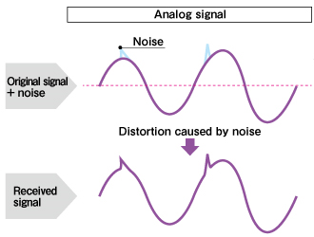
Analog Transmission
Analog signal transmitted without regard to content
May be analog or digital data
Attenuated over distance
Use amplifiers to boost signal
Also amplifies noise!
Amplify-and-forward

Slide 46
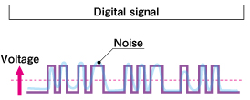
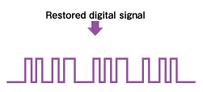
Digital Transmission
Intermediate nodes aware of content
Integrity endangered by noise, attenuation etc.
Repeaters used, which
receives signal
Extracts bit pattern
Retransmits
Overcome signal attenuation without amplifying noise!
Advantages over analog transmission:
data integrity: lower error rate, longer distance
decode-and-forward

Slide 47
Modulation and Coding
Digital Data, Analog Signal
Analog Data, Digital Signal
Analog Data, Analog Signal
Digital Data, Digital Signal

Slide 48
Analog Data, Digital Signal
Digitization
Conversion of analog data into digital data
Digital data can then be transmitted
The transmission may first convert the digital data back to an analog signal (different from original)
The conversion done using a codec
Notes:
Actually 2-step process: analog data -> digital data -> digital/analog signal

Slide 49
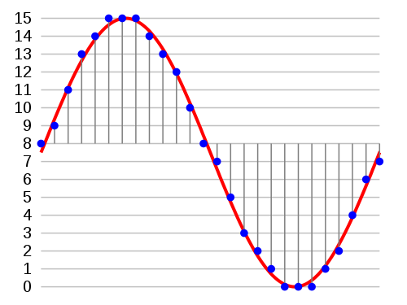
Pulse Code Modulation (PCM)
Nyquist Sampling Theorem: If a signal is sampled at regular intervals at a rate higher than twice the highest signal frequency, the samples contain all the information of the original signal.
Example: Voice data limited to below 4000Hz
Require 8000 sample per second
Each sample assigned digital value → Quantization
E.g., 4-bit quantization gives 16 levels, 8-bit quantization gives 256 levels
To modulate voice with 256 levels, we need 8000 samples/sec of 8 bits each → data rate is 64 kbps
→ Tradeoff: more bits per sample means smaller quantization error but more bits generated
8 9 11 13 14 15 15 15 ...
10001001101111011110111111111111 ...

Slide 50
Review
Digital data → analog signal conversion
baseband: line codes
passband: ASK, FSK, PSK, QAM
Analog data → digital signal conversion
sampling, quantization
Notes:
End of lecture 3.

Slide 51
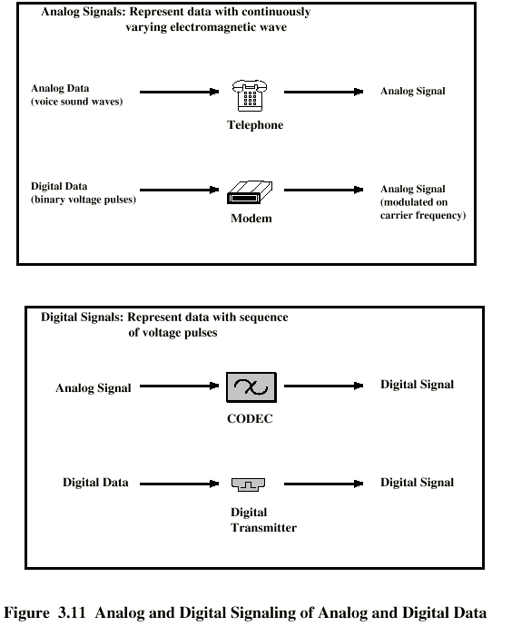
Analog Signals Carrying Analog and Digital Data

Slide 52
Digital Signals Carrying Analog and Digital Data
Data
Notes:
this is about recording audio on CD

Slide 53
Channel Capacity
Data rate
In bits per second
Rate at which data can be communicated
Bandwidth
In cycles per second or Hertz
Constrained by transmitter and medium
The two are proportional to each other:
Nyquist Theorem (noiseless channel): maximum data rate = 2B log₂V bits/sec
B – channel bandwidth (must sample at twice this rate)
V – discrete levels of signal (e.g., 2 if we are using 1 and 0)
Shannon’s Theorem (noisy channel): maximum data rate = 2B log₂(1 + S/N) bits/sec
B – channel bandwidth
S – signal power
N – noise power

Slide 54
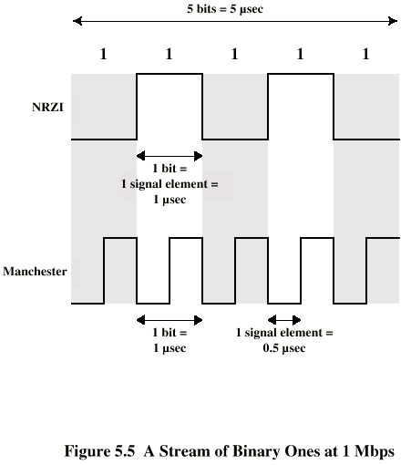
Modulation Rate

Slide 55
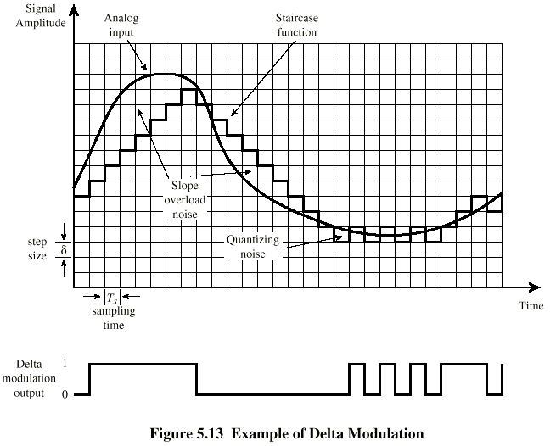
Delta Modulation
Analog input is approximated by a staircase function
Move up or down one level (δ) at each sample interval
Binary output: 1 - moving up, 0 - moving down
easier to compress

Slide 56
Modulation and Coding
Digital Data, Analog Signal
Analog Data, Digital Signal
Analog Data, Analog Signal
Digital Data, Digital Signal

Slide 57
Analog Data, Analog Signals
Why modulate analog signals?
Higher frequency can give more efficient transmission
Permits frequency division multiplexing (chapter 8)
Types of modulation
Amplitude
Frequency
Phase

Slide 58
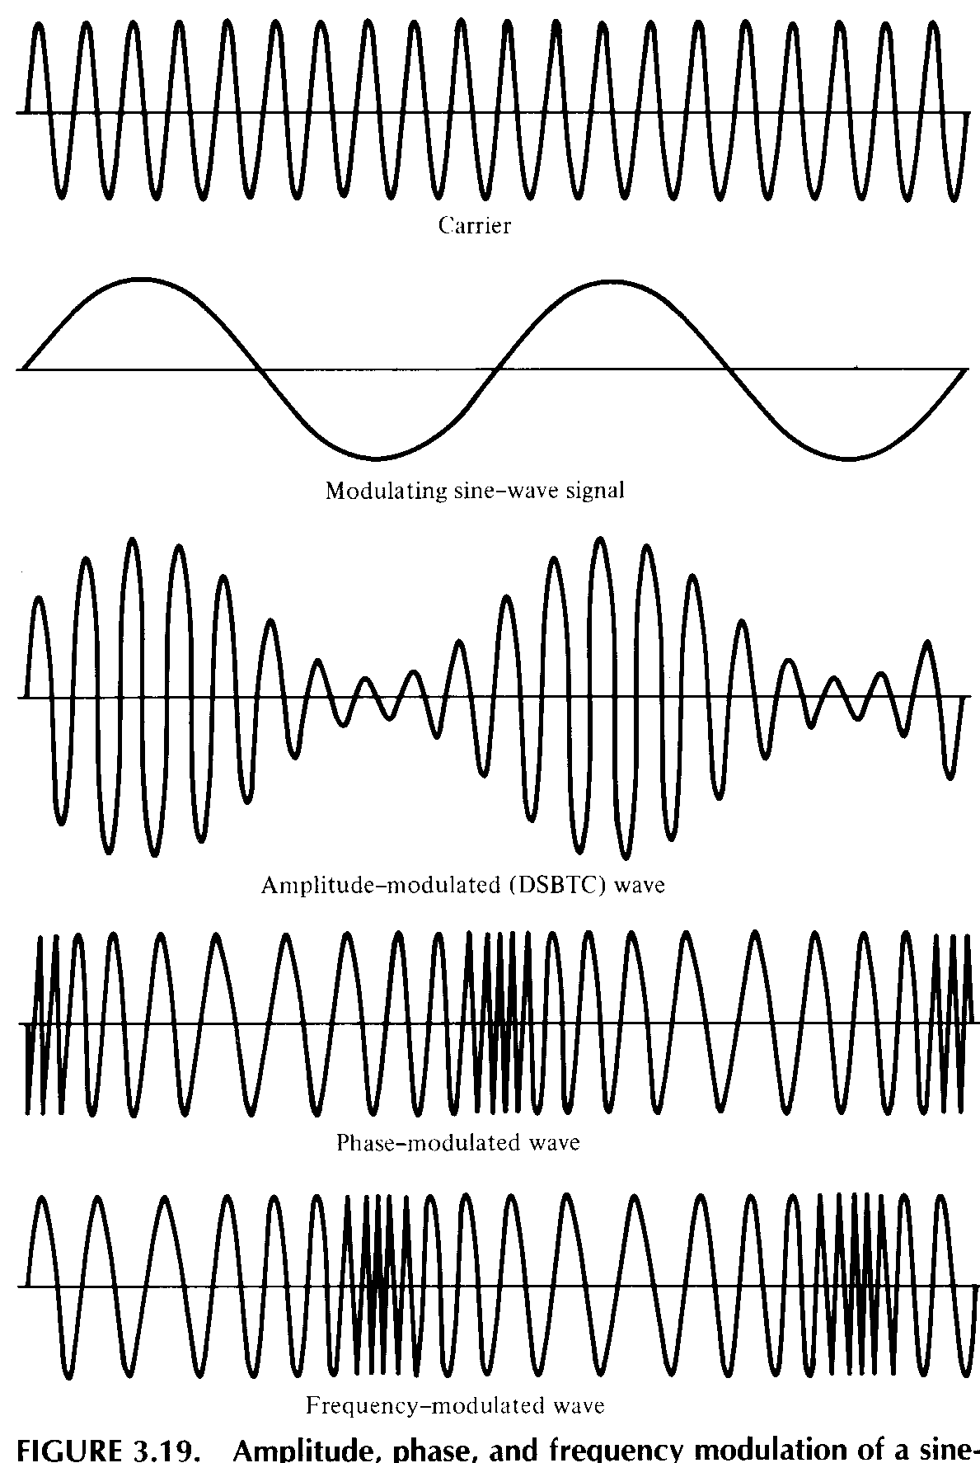
Analog Modulation

Slide 59
Modulation and Coding
Digital Data, Analog Signal
Analog Data, Digital Signal
Analog Data, Analog Signal
Digital Data, Digital Signal

Slide 60
Digital Data, Digital Signal
Digital signal
Discrete, discontinuous voltage pulses
Each pulse is a signal element
Binary data encoded into signal elements

Slide 61
Transmission Media
Guided
Twisted Pair
Coaxial cable
Optical fiber
Free space
Wireless

Slide 62

Twisted Pairs
Category 5 UTP cable with four twisted pairs
Computer Networks, Fifth Edition by Andrew Tanenbaum and David Wetherall, © Pearson Education-Prentice Hall, 2011

Slide 63
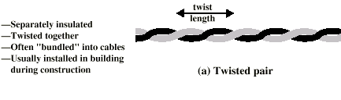
Twisted Pair
Most common medium
Telephone network
Between house and local exchange (subscriber loop)
Within buildings
To private branch exchange (PBX)
For local area networks (LAN)
10Mbps or 100Mbps
Analog
Amplifiers every 5km to 6km
Digital
Use either analog or digital signals
repeater every 2km or 3km
Limited distance
Limited bandwidth (1MHz)
Limited data rate (100MHz)
Susceptible to interference and noise

Slide 64
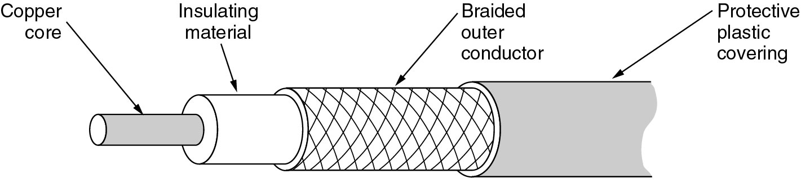
Coaxial Cable
Most versatile medium
Television distribution
Ariel to TV
Cable TV
Long distance telephone transmission
Can carry 10,000 voice calls simultaneously
Being replaced by fiber optic
Short distance computer systems links
Local area networks
Analog
Amplifiers every few km
Closer if higher frequency
Up to 500MHz
Digital
Repeater every 1km
Closer for higher data rates

Slide 65

Fiber Cables
Greater capacity
Data rates of hundreds of Gbps
Smaller size & weight
Lower attenuation
Electromagnetic isolation
Greater repeater spacing
10s of km at least
Long-haul trunks
Metropolitan trunks
Rural exchange trunks
Subscriber loops
LANs

Slide 66
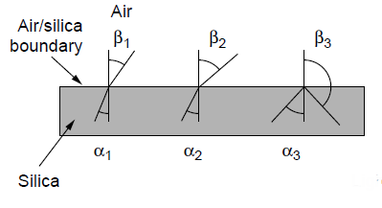
Fiber Optics (1)
Three examples of a light ray from inside a silica fiber impinging on the air/silica boundary at different angles.
Computer Networks, Fifth Edition by Andrew Tanenbaum and David Wetherall, © Pearson Education-Prentice Hall, 2011

Slide 67
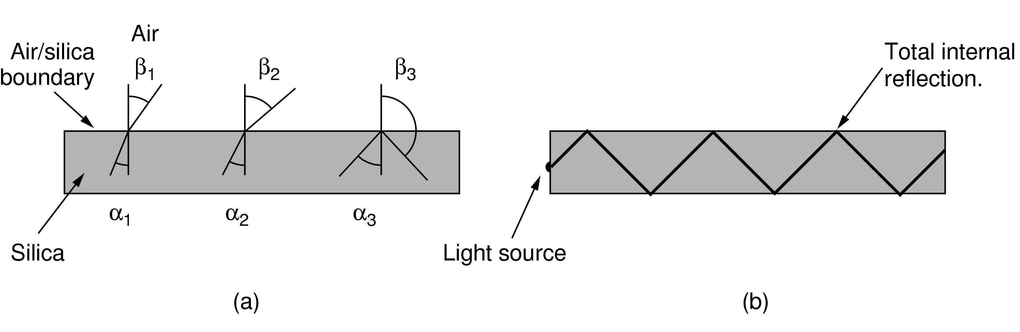
Fiber Optics (2)
Light trapped by total internal reflection.
Computer Networks, Fifth Edition by Andrew Tanenbaum and David Wetherall, © Pearson Education-Prentice Hall, 2011

Slide 68
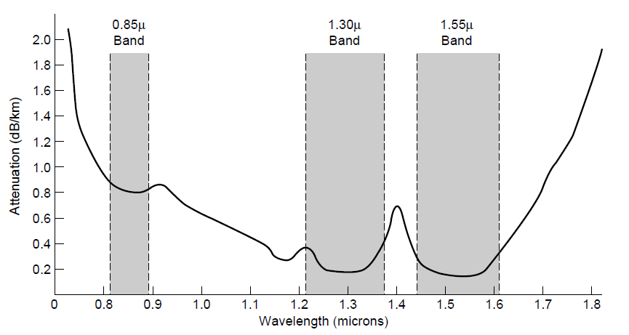
Transmission of Light Through Fiber
Attenuation of light through fiber in the infrared region
Computer Networks, Fifth Edition by Andrew Tanenbaum and David Wetherall, © Pearson Education-Prentice Hall, 2011

Slide 69
Wireless Transmission
Multipath fading
Rayleigh Fading
statistical model of fading over the air
Distortion
can be combated with equalizers
Shadows
obstructions
T + t
T
or

Slide 70
Channels
Allow more than one session to take place on a single physical link
Increases network capacity

Slide 71
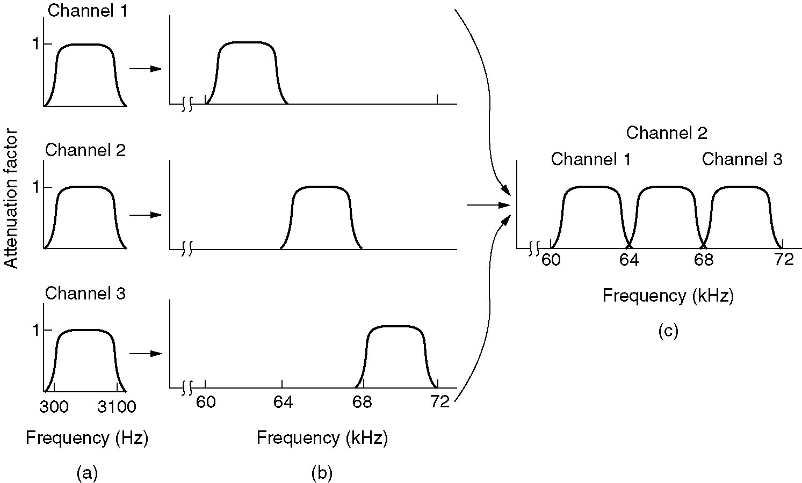
Frequency Division Multiplexing
(a) The original bandwidths.
(b) The bandwidths raised in frequency.
(b) The multiplexed channel.

Slide 72
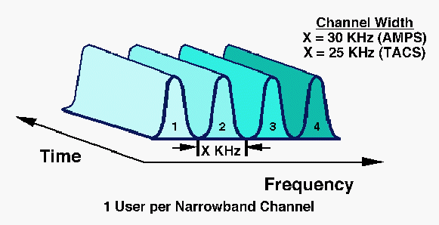
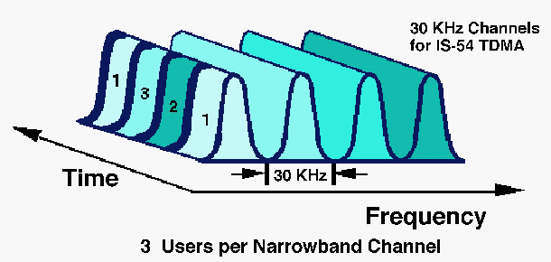
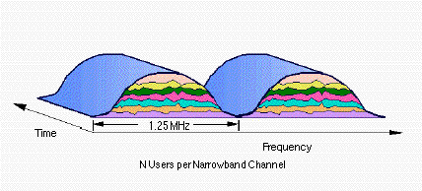
Wireless Access Basics
Frequency Division Multiple Access (FDMA):
e.g. the analog cellular system: 1G
Time Division Multiple Access (TDMA):
e.g. IS-54 and IS-136, GSM, PDC: 2G
GPRS: 2.5G
UWC-136, EDGE: 3G
Code Division Multiple Access (CDMA):
e.g. IS-95A,B (cdmaOne) : 2G
IS-2000 (cdma2000), WCDMA : 3G
4

Slide 73
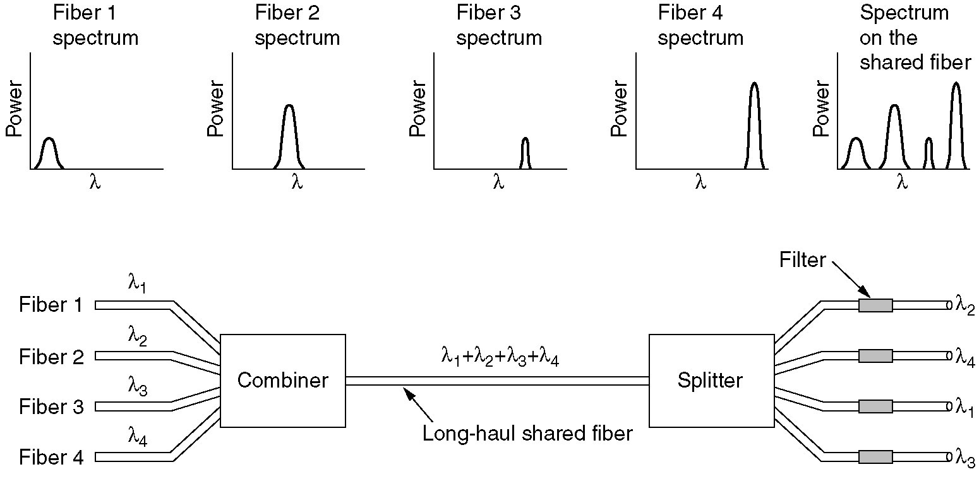
Wavelength Division Multiplexing
Wavelength division multiplexing.

Slide 74
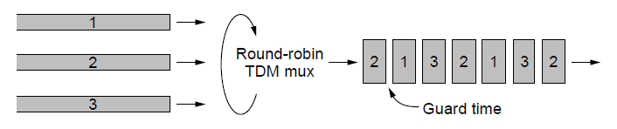
Time Division Multiplexing
Time Division Multiplexing (TDM).
Computer Networks, Fifth Edition by Andrew Tanenbaum and David Wetherall, © Pearson Education-Prentice Hall, 2011

Slide 75
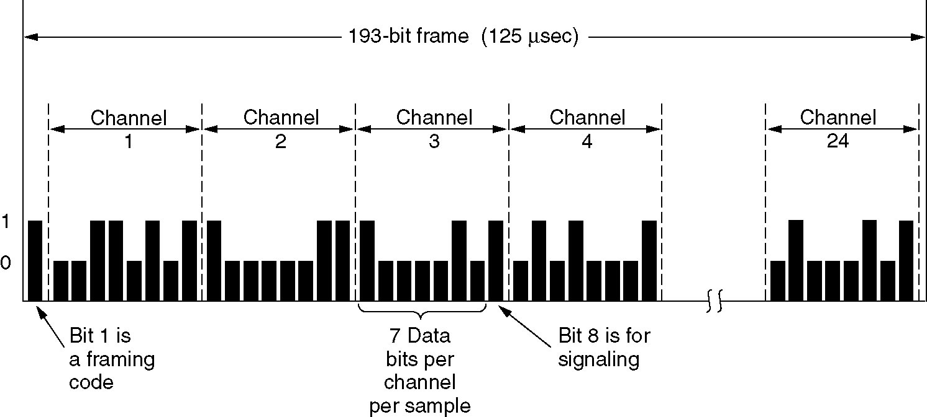
Time Division Multiplexing
The T1 carrier (1.544 Mbps).

Slide 76
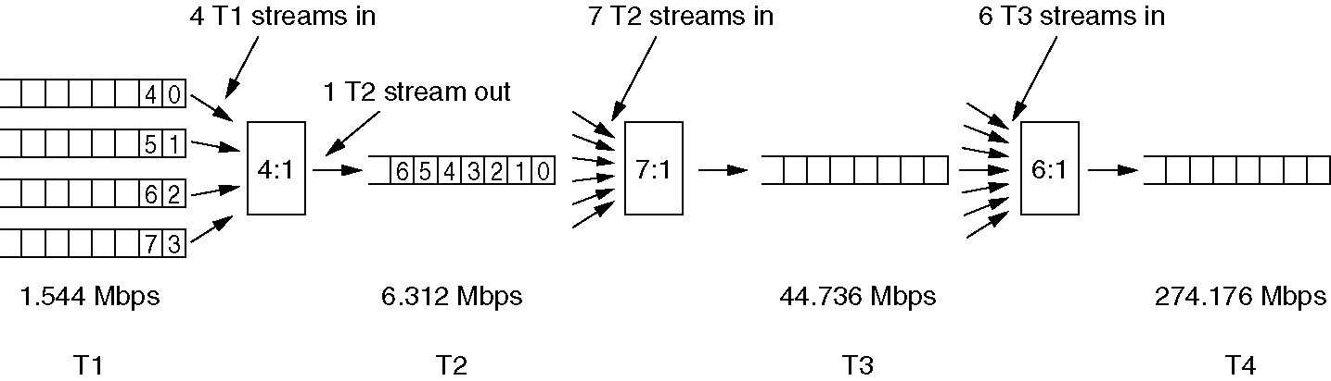
Time Division Multiplexing (3)
Multiplexing T1 streams into higher carriers.

